Slide 1
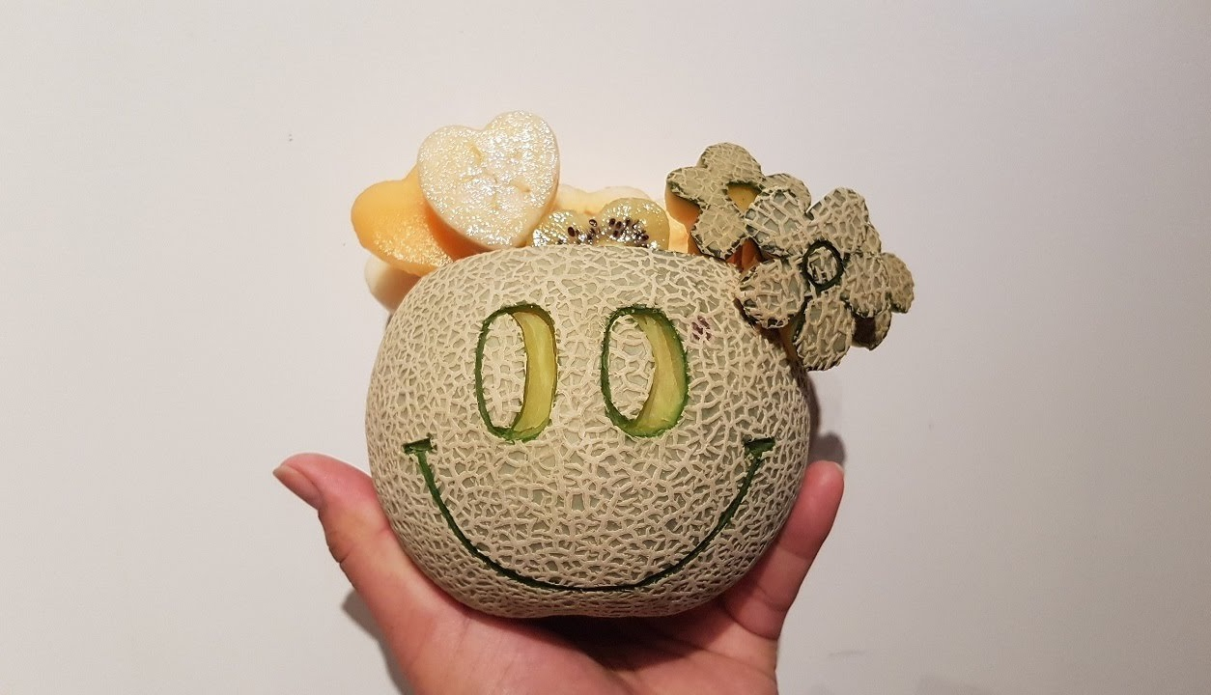
Crispy Cantaloupes
Sprint- 3

Slide 2

Minimum Viable Product
BUG FREE
Basic piece moves
Simple captures
Multi-capture turns
Kinging of a piece and the new move capabilities the King piece has
Invalid moves including checking for required captures
End of game scenario
Resign from game

Slide 3
Enhancements
Fully Implemented + Bug Free
Player Help: Extend the Game View to support the ability to request help.
AI Player: Players may play a game against an artificial intelligence player.
Still being implemented

Slide 4
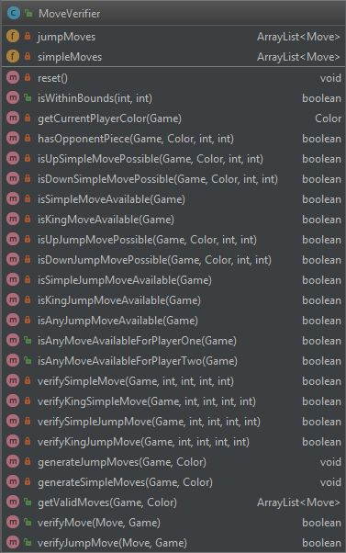
Highlights
We are particularly proud of our MoveVerifier class
As you can see, it takes care of recognizing and validating moves
It also has an active list of simpleMoves and jumpMoves available for individual pieces
This is how we were able to implement our first enhancement: Player Help
We were able to provide over 90% code coverage for the model tier

Slide 5
Trello
https://trello.com/b/HYk4rzx8/webcheckers-project-team-c-crispycantaloupes

